Slide 1
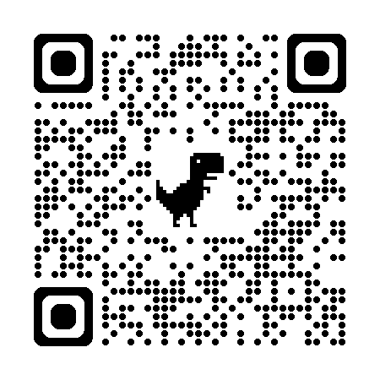

Introduction to Scientific Computing
ENGR1050 – Lecture 1
Fall 2025
Nat Trask
University of Pennsylvania

Slide 2

Computing
What is it
Course Organization
Syllabus, Schedule, Gameplan
Hello World
Submit a dummy assignment to make sure you have a working environment

Slide 3
Who am I?

Slide 4




About me
I joined Penn as an Associate Prof in August 2023
I was senior staff at Sandia National Laboratories 2016-2023, and hold a joint faculty appointment still
I earned my Ph.D. in Applied Mathematics at Brown University in 2015, and hold dual Bachelor degrees in Mechanical Engineering and Applied Mathematics from University of Massachusetts.
I’ve run a consulting simulation business since 2010.
My research focuses on integrating AI/ML with simulation to predict extreme physics

Slide 5
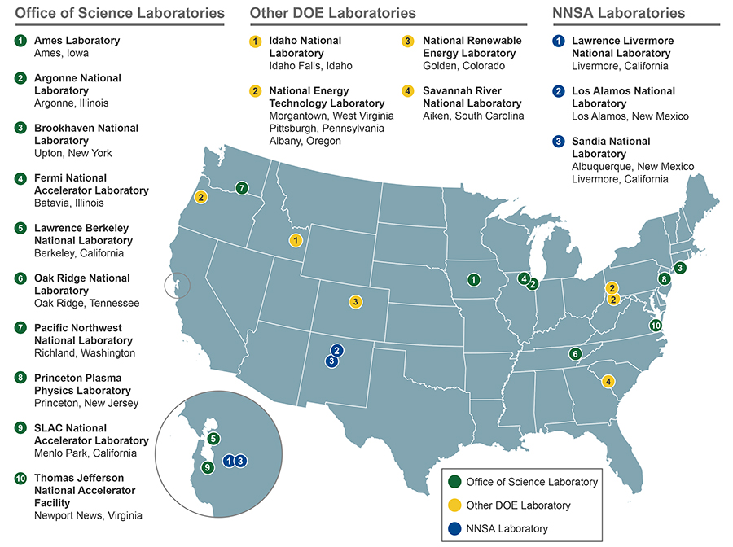

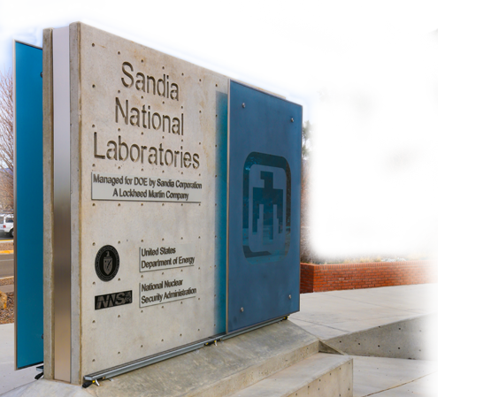
Department of Energy and the National Lab Complex
What is a national laboratory?
Funders of science in US: DoD $120B/yr NIH $33B/yr DoE $19B/yr
NSF $8B/yr
(2023 numbers)
Sandia Albuquerque

Slide 6
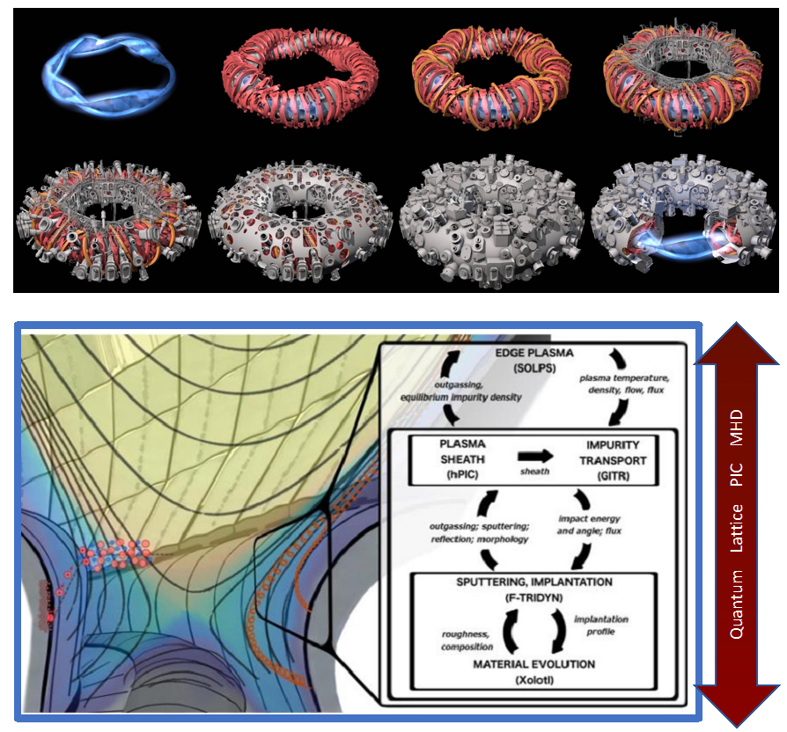
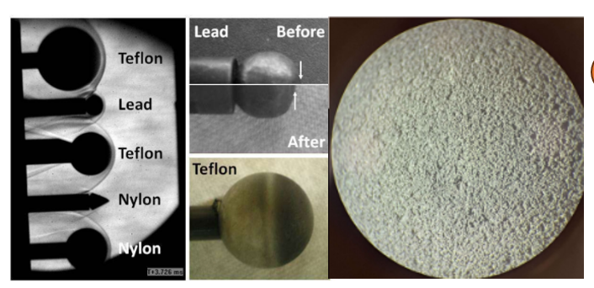
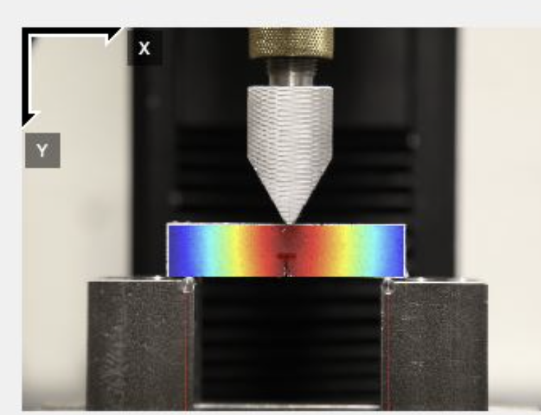
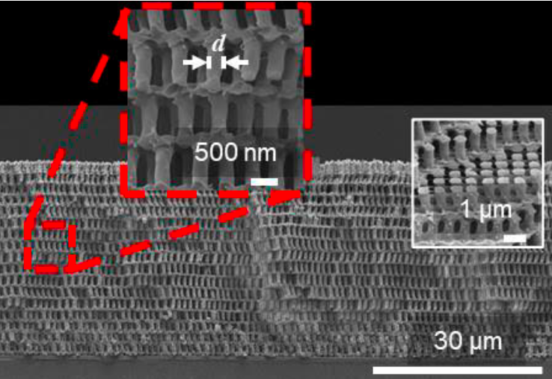
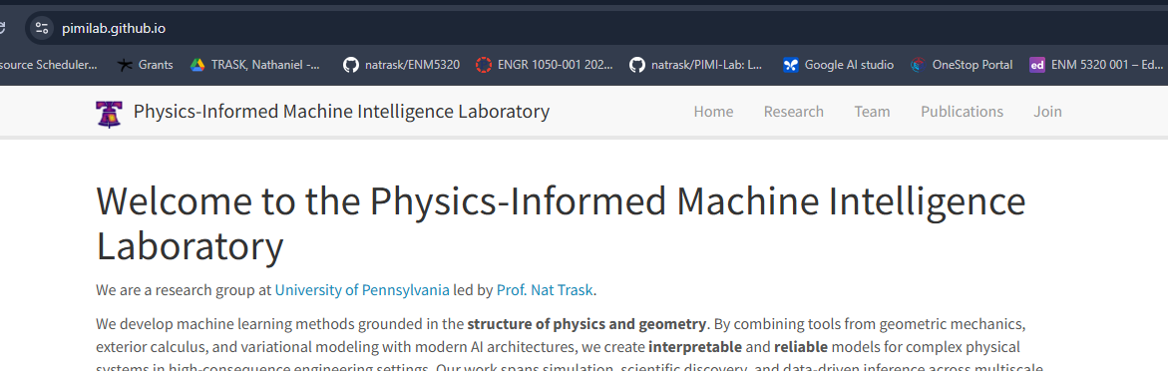
My research: AI/ML for extreme physics systems

Slide 7

Who are you?
https://docs.google.com/forms/d/e/1FAIpQLSc1UDwakuD2Lf_wzMUMT0s5adWvUm0tPbza-UUSTpMYnTtLtQ/viewform?usp=sharing&ouid=109470157790519172092

Slide 8
What is scientific computing, and why are we learning how to do it?

Slide 9
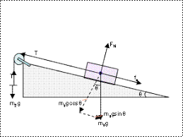
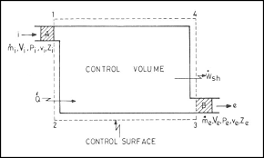
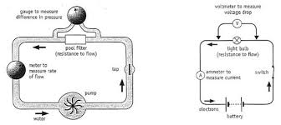
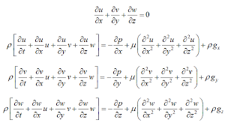
Scientific computing is a tool to solve models of physical systems
Free body diagrams
Control volume analysis
Circuit models
Differential equation models
During your degree, you will learn to build mathematical models that describe the behavior of physical systems and let you optimize their design

Slide 10
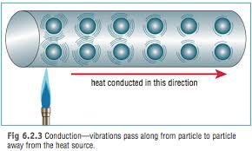
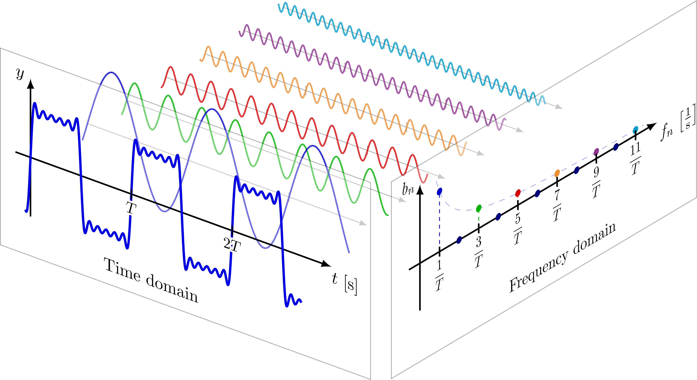
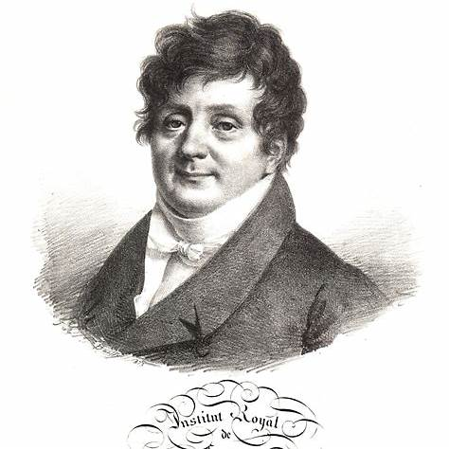
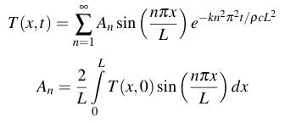
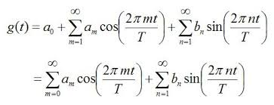
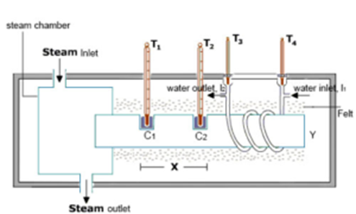
Why do we learn calculus? Once, there were no computers

Slide 11
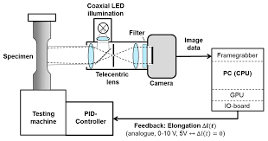
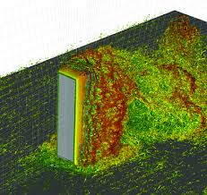
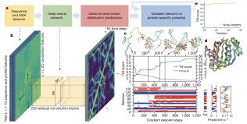
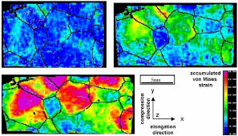
Analytical models vs experiments, computation, and statistical models
Analytical models are
When we can’t get an analytical model?
Good at:
Giving closed form expressions
Interpretability
Exploring qualitative regimes
Bad at:
Handling real world complexity
Limited by the math we can work out by hand!
Experimental methods
Computational methods
Statistical/AI methods

Slide 12
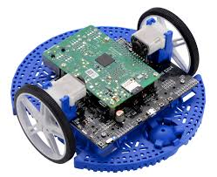
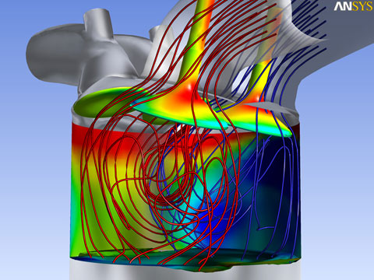

Scientific computing, from the big to the small
Microcontrollers
Small computers controlling engineering systems and robotics
Industrial Computation
Simulations for industrial design that run on a desktop workstation
Supercomputing
Solving the biggest open problems in science + AI consuming the power of 16000 homes

Slide 13
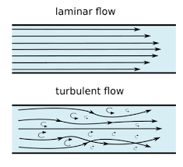
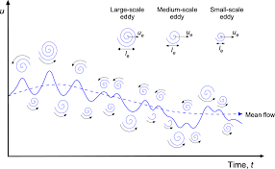
What does a large scale computing problem look like?
1 FLOP = 1 floating point operation
An add, subtract, multiply, divide
FLOPS are currency – and scales with the number of unknowns you’re going to solve for

Slide 14
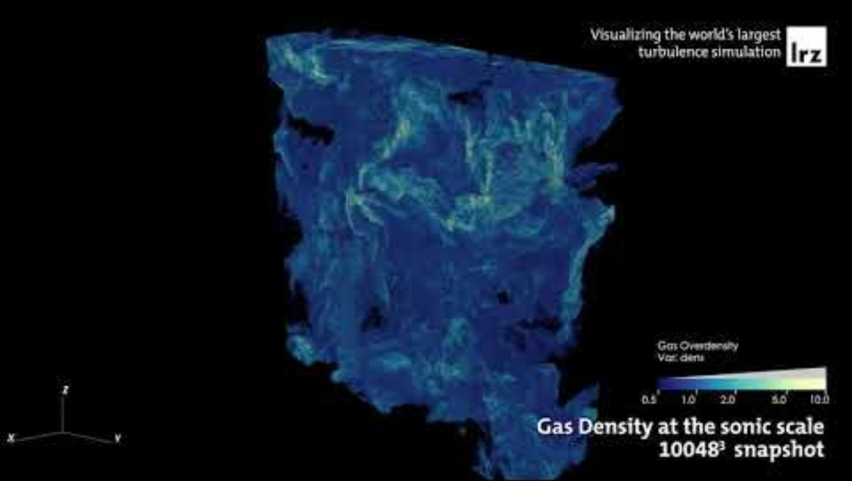
Massive scale turbulence simulation

Slide 15
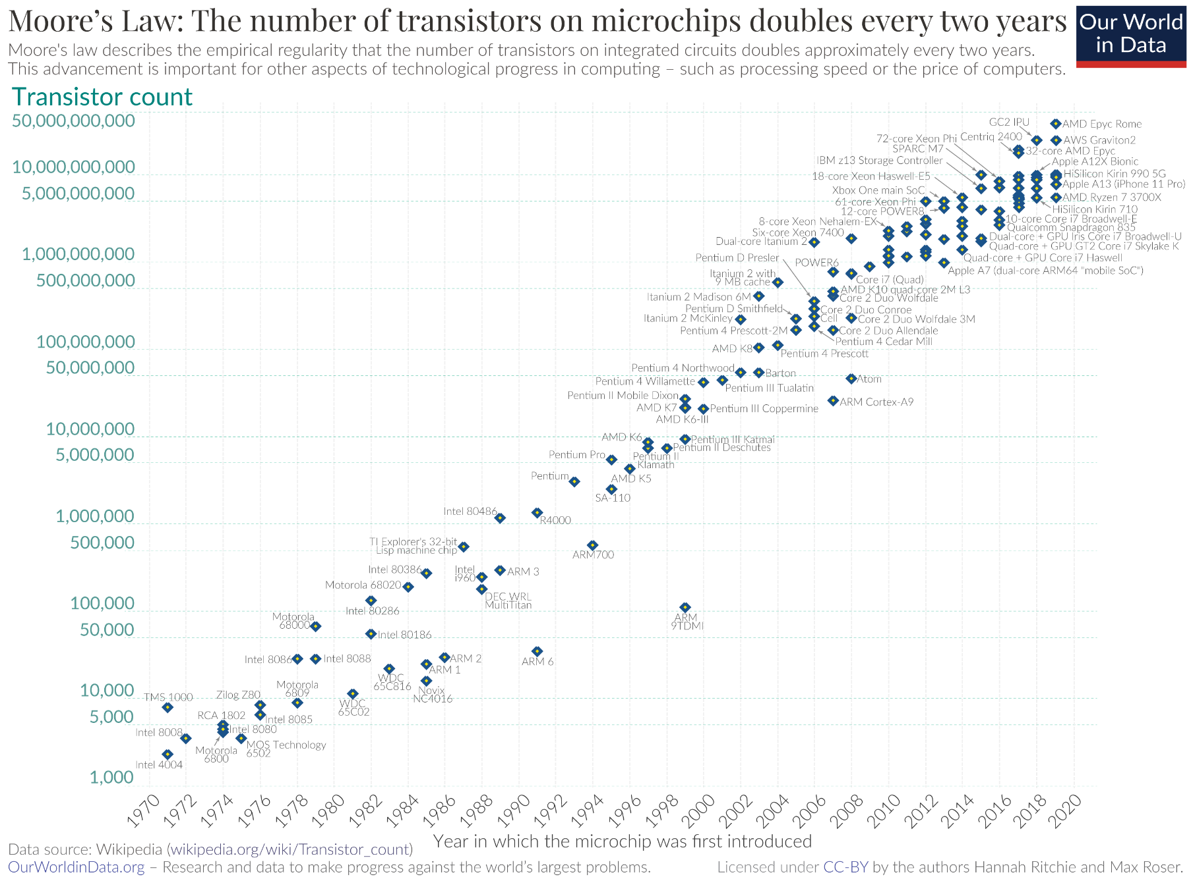
Over time, computers get larger = we can solve bigger problems

Slide 16
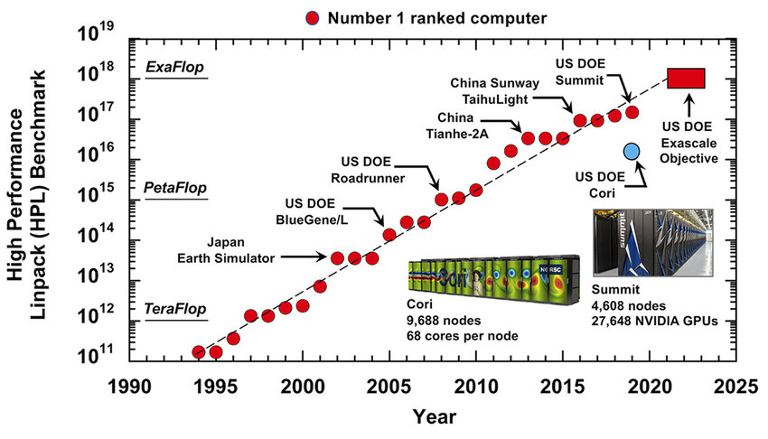
Supercomputers represent the largest scientific problems that can be solved

Slide 17
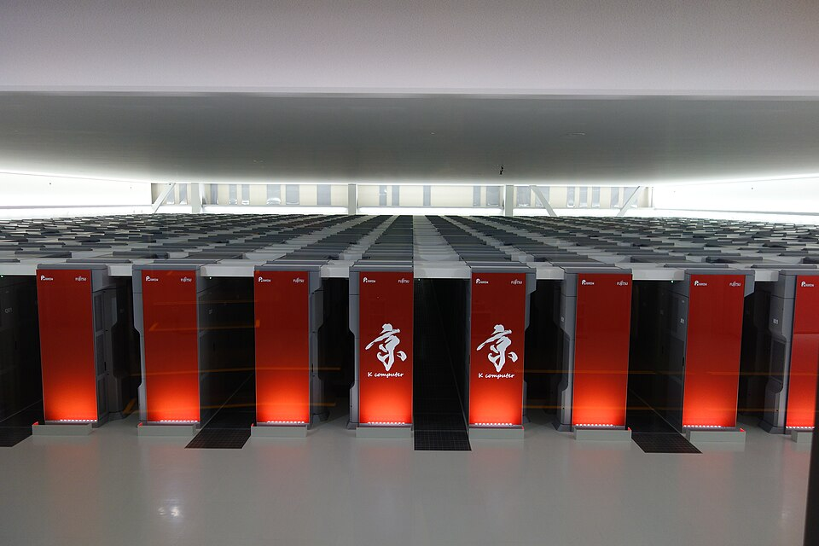
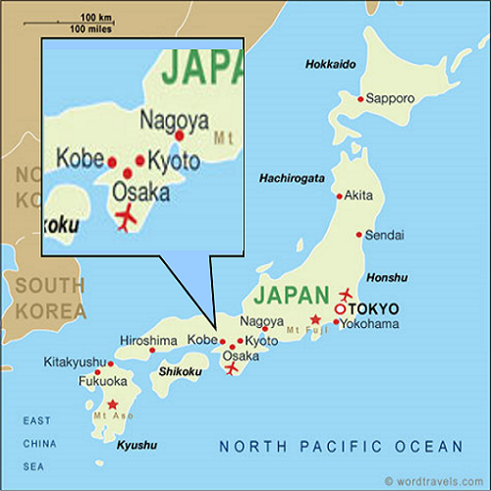
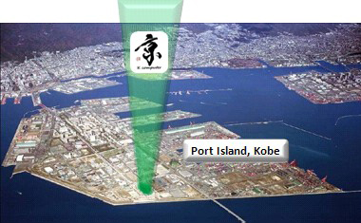
Supercomputers represent the largest scientific problems that can be solved

Slide 18
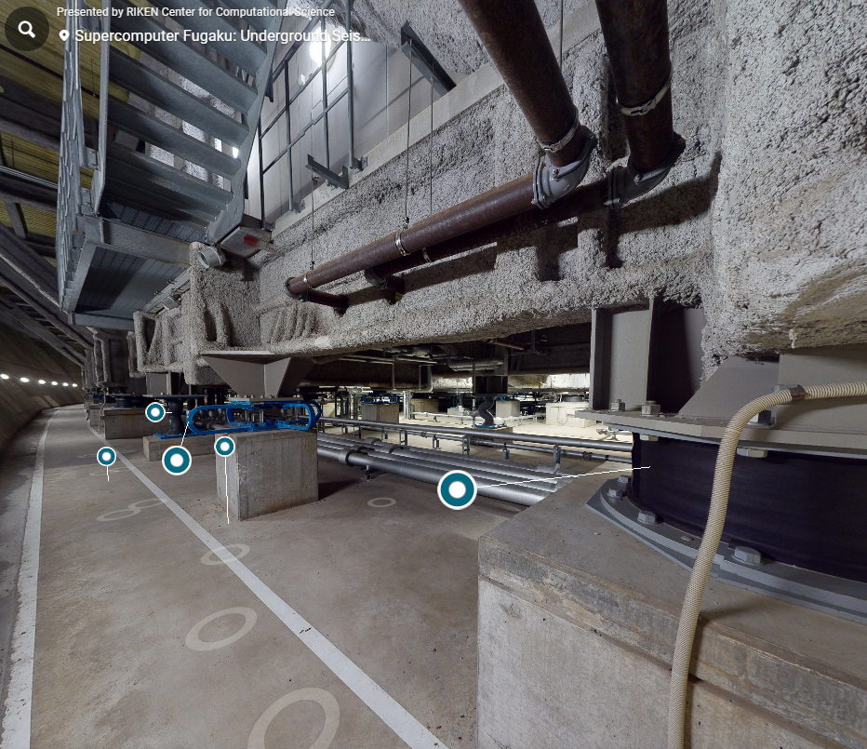
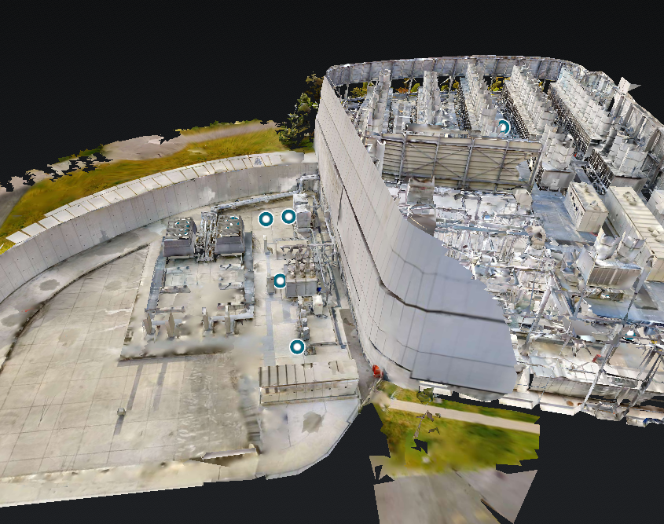
Supercomputers represent the largest scientific problems that can be solved
Virtual tour of earthquake isolation system
Virtual tour of cooling and power plant

Slide 19
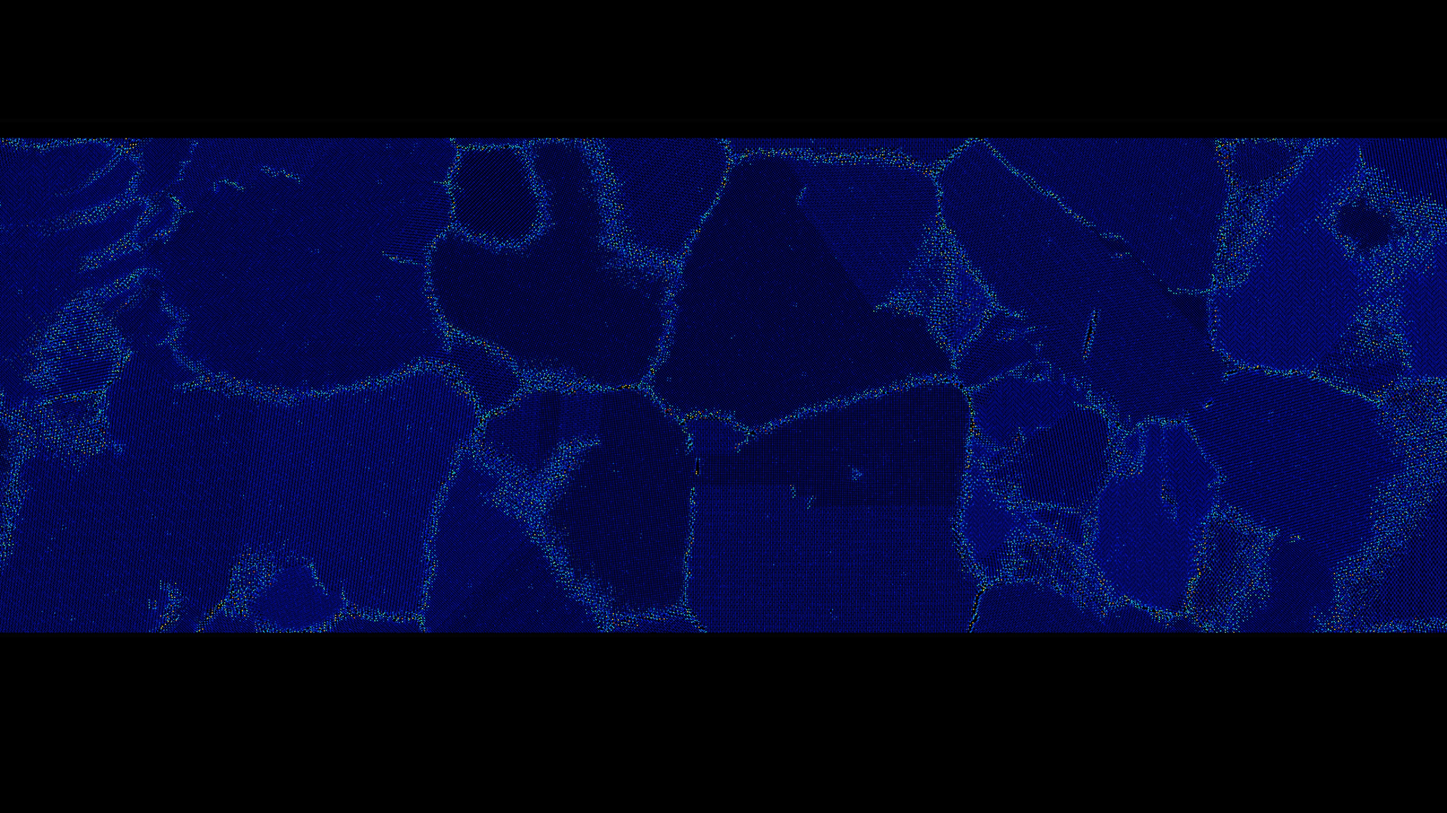
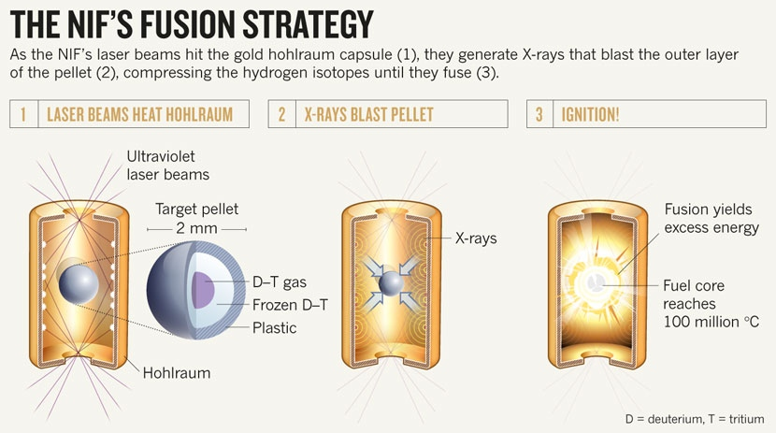
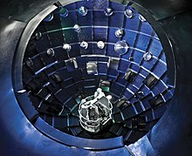
Examples: Realizing fusion power (National Ignition Facility at Livermore National Lab)

Slide 20
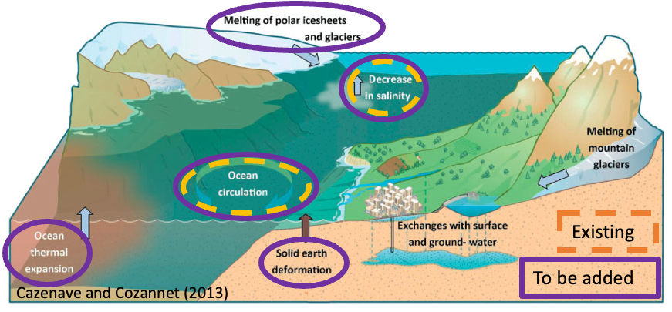
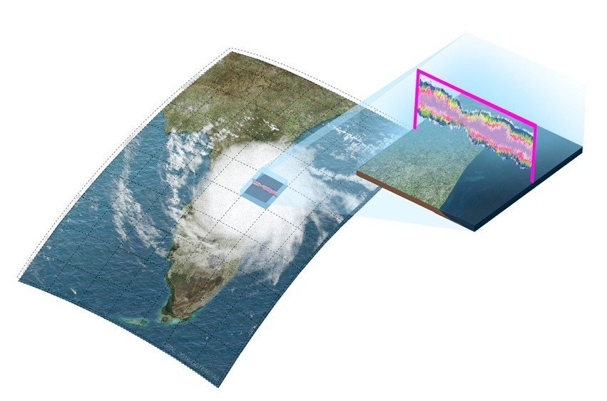
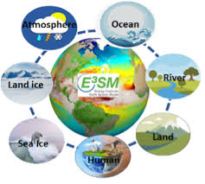
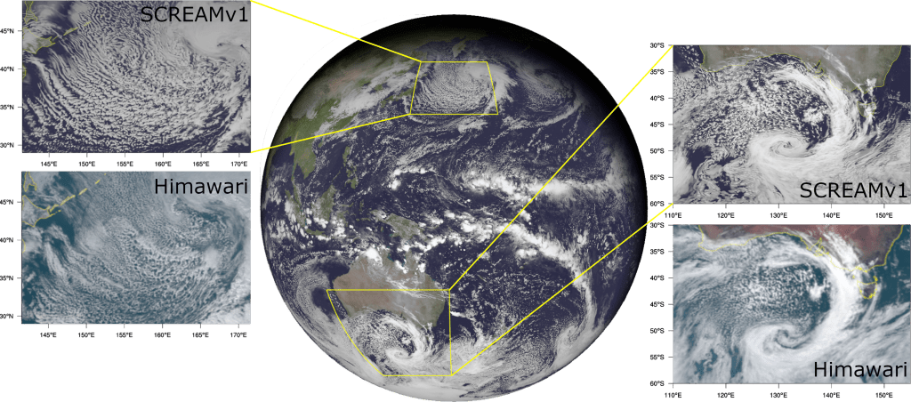
Examples: Simulating weather/climate (Earth exascale computing project E3SM in DOE)

Slide 21
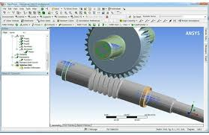
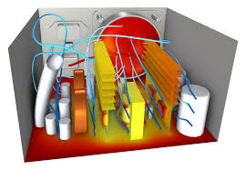
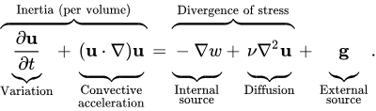


Practical scale computing – computational fluid/solid mechanics + electromagnetism
Mathematical model describes flow Conservation of mass/momentum/energy
CAD geometry gives discrete model Map equations onto something we can solve on a computer
Preprocessing
(CAD)
Calculation
(FEM/CFD)
Post-processing

Slide 22
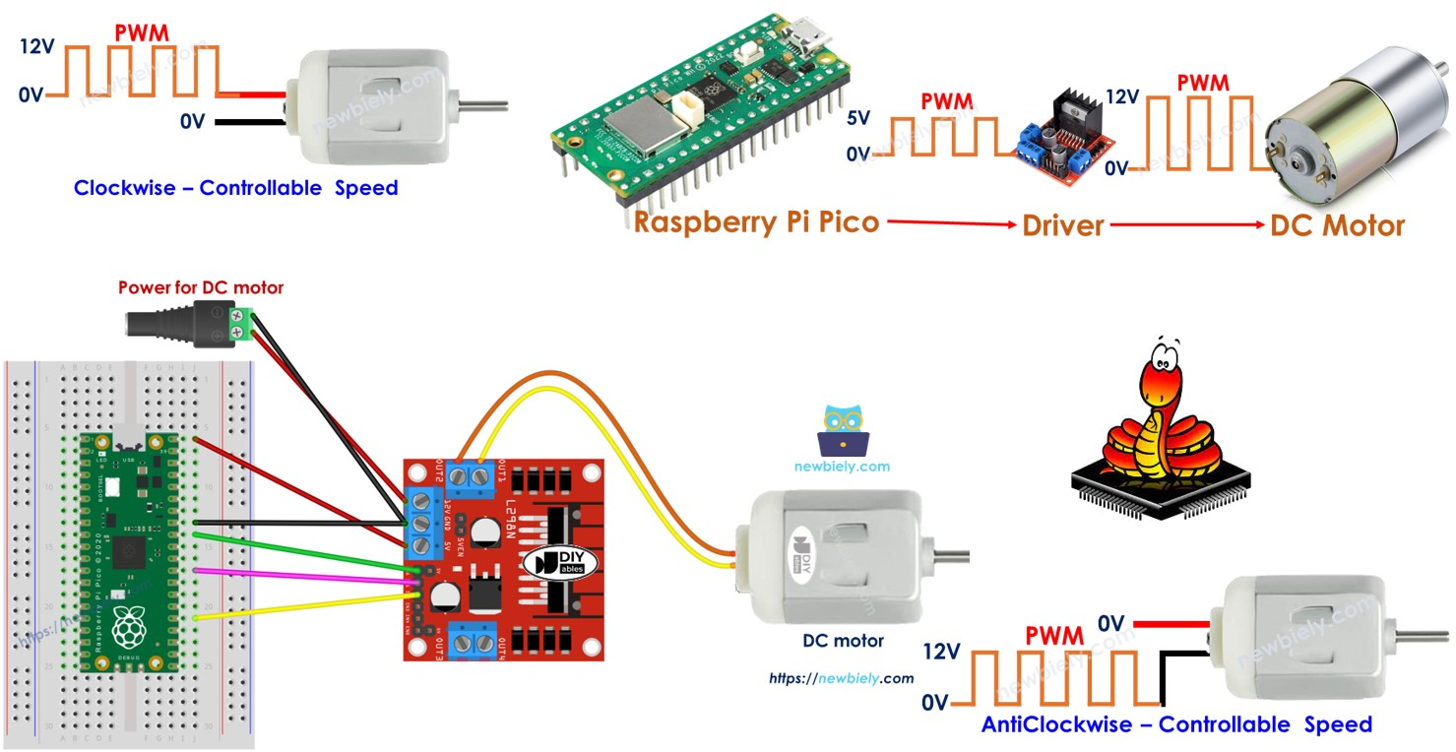
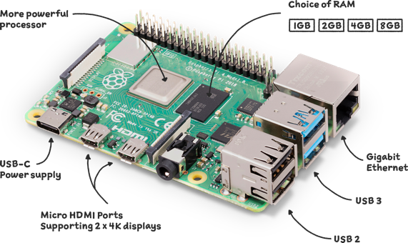
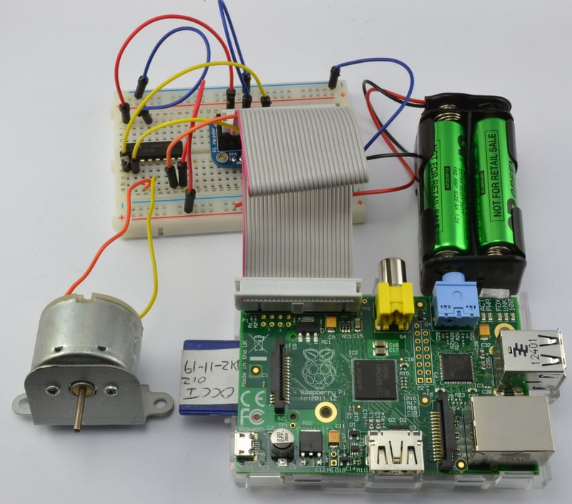
Microcontrollers for robotics
Lightweight computers integrated with sensors Useful for robotics, prototyping designs,

Slide 23
How is this course organized?
Everything is on the course Github: https://github.com/PIMILab/ENGR1050

Slide 24
Course goals: at the end of this course you will:
Understand the fundamentals of Python
Be able to write programs (without AI help) that implement a mathematical concept
Be able to write programs that can collect and process data
Be able to use packages/libraries for advanced tasks
Understand the fundamentals of scientific computing
Be able to numerically solve common engineering calculations
Be able to generate plots and prepare reports for your future classes
Understand the fundamentals of machine learning
Be able to run a simple machine learning model
Be able to explain in mathematical words what an AI model does
Be able to use AI while maintaining ethical responsibility as an engineer
Understand how to code a microcontroller
Be able to code a simple microcontroller integrating simple sensor data
Be able build prototypes for future design projects

Slide 25
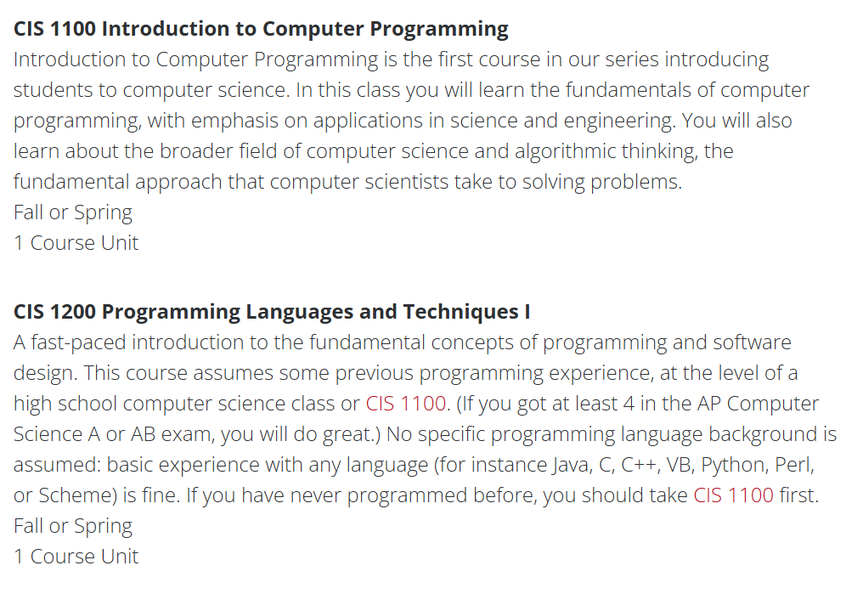
Should I take this or should I take the CIS equivalent
Satisfies the same requirement for some majors
This class is more hands on
Tailored to specific needs of engineering majors
Scientific computing, differential equations, Arduino, hands-on
CIS1100/1200 sets up for higher-level CIS sequence
If you plan to take upper level CIS classes, ENGR1050 may not be best option
Happy to discuss if you have questions.
If you need a course substitution form filled, bring it to my office hours

Slide 26
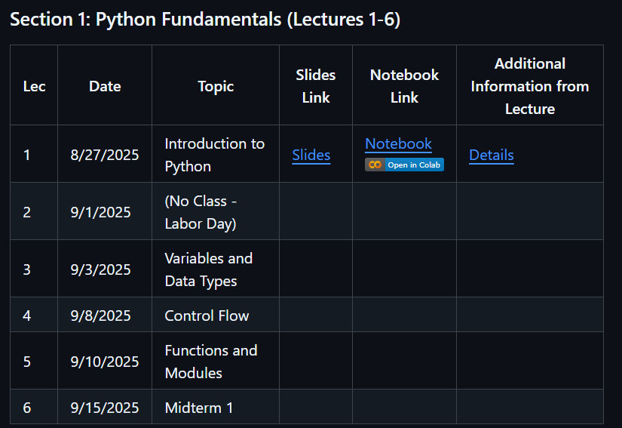
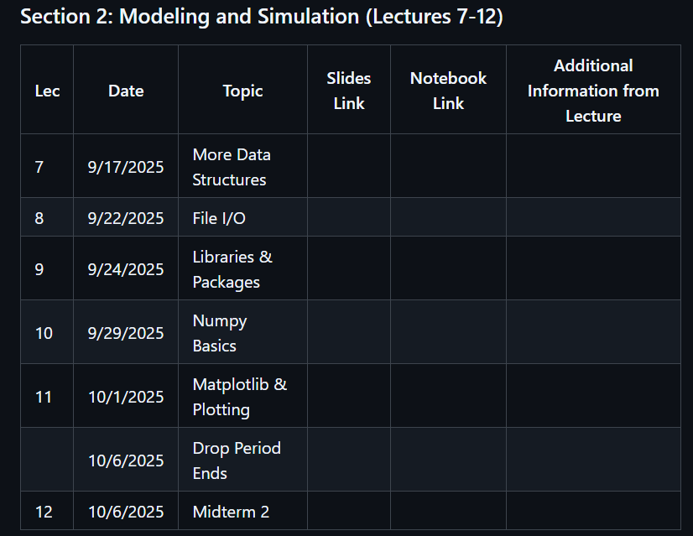


Broken into four sections
Not up to date yet
“Exams” at end of each section
Links to slides/jupyter notebooks/ additional material
Assignments submitted through canvas

Slide 27
Types of lectures that we’ll do
Groupwork days
Short guidance (<30m) on new material, what to do
Break into groups of 2-5
I+TA will float around answering questions
Periodic check-ins to stay on task
Submit work on canvas when complete
Coding demo days
Slides introducing new concepts
Blackboard for derivations
Live coding where I will step through how to approach a problem
Labwork days
Meet in the GM lab in Towne
Will be listed ahead of time on course calendar with reminder on Ed
Working with Arduino
Some free lectures at end of semester to work on final projects w/ groups
“Exam” days
Short review
Pencil and paper written exams
Easy if you have done material on your own

Slide 28





Where to find the GM lab
Will have swipe access
Arduinos and circuit components will be accessible during class hours
Independent group work, submit to canvas when finished
For final projects, materials will be accessible
Be respectful of shared space

Slide 29


Grading policy
Submit HW in Canvas
(link at top of github)
Make sure you list all contributors For groupwork, double check your group lead successfully submitted
When in doubt, submit screenshots of output

Slide 30

Communication with Prof. Trask outside of class
Office hours! Office hours! Office hours! Office hours!
Do not count on me responding to any email
Use edstem.org for all questions:
Share a public message for questions that will be of benefit to the whole class
Be careful about sharing private information
Private, non-anonymous messages for personal questions
Technical questions are very welcome
We aim for 24-48hr turnaround

Slide 31

AI policy

Slide 32


It is very easy for us to tell if you are copying and pasting AI code
Task:
Print the average of a list of numbers

Slide 33


Group work submission on canvas
Step 1: Join group
Open canvas
Click people tab
Choose group (Lecture 01)
Identify an empty group slot
Have everyone in your group join the same one
You are now a group!
Step 2: Submit to canvas
One group member needs to submit
Automatically distributed across whole group
Double check that it shows up as submitted for everyone in group

Slide 34

Rest of class, we will be working through a jupyter notebook

